Slide 1


MPRINT - Open Knowledge Network (Chemical and Materials Informatics) Workshop
March 12, 2020

Slide 2

Agenda: Welcome
8:45AM Opening Remarks
James Ferri, Virginia Commonwealth University

Slide 3
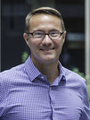
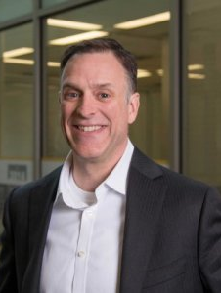

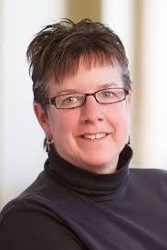

Our team
Accelerating chemical and materials innovation by harnessing the data revolution
Ferri
McQuade
Henshaw
Parish

Slide 4
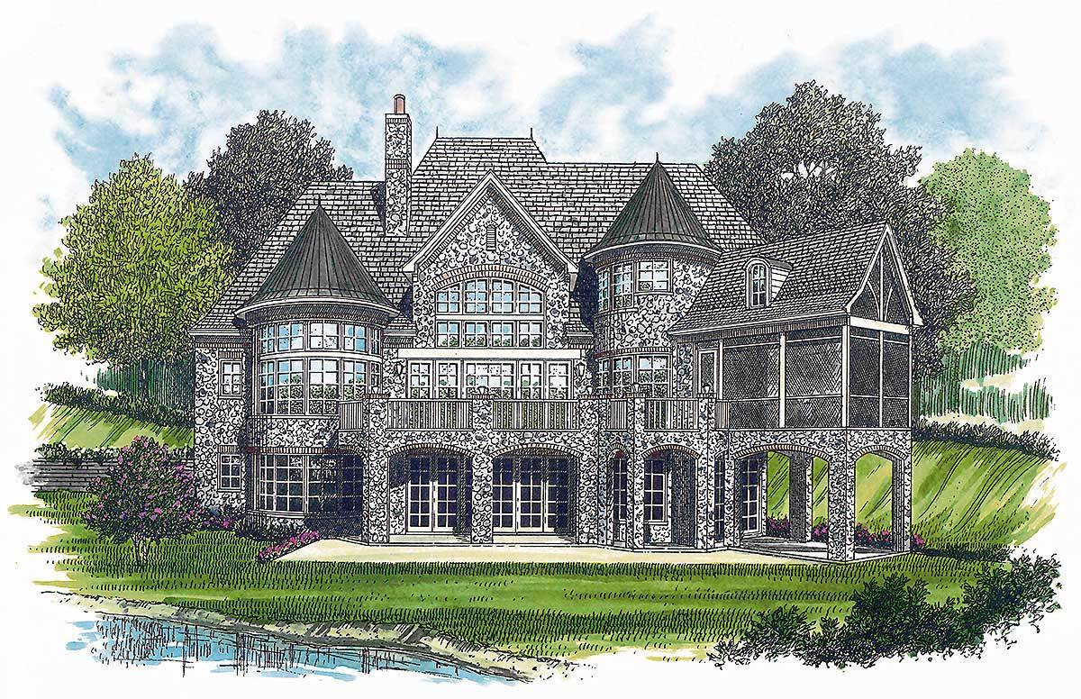









A new opportunity
Chemicals/Materials Design Company
Market/Customer
Discovery
Design
Manufacture
Open Knowledge Network: public-private partnership of chemical and materials data
opportunity
Application Performance
Public Chemical/Materials Data
innovation

Slide 5
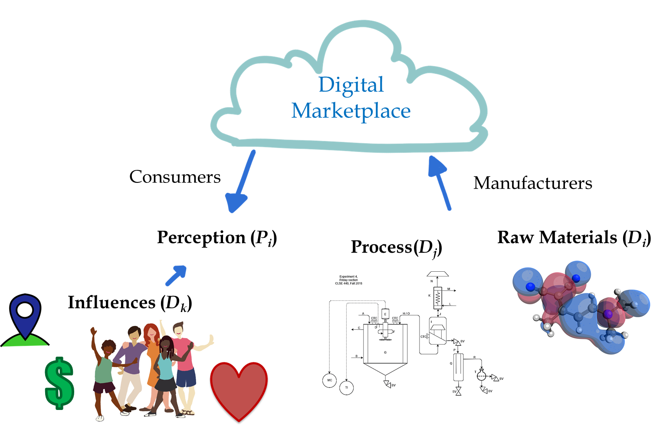
Accelerated product design
Application Performance
Public Chemical/Materials Data
P_{i} = k’(D_{i} , D_{j} , D_{k})

Slide 6
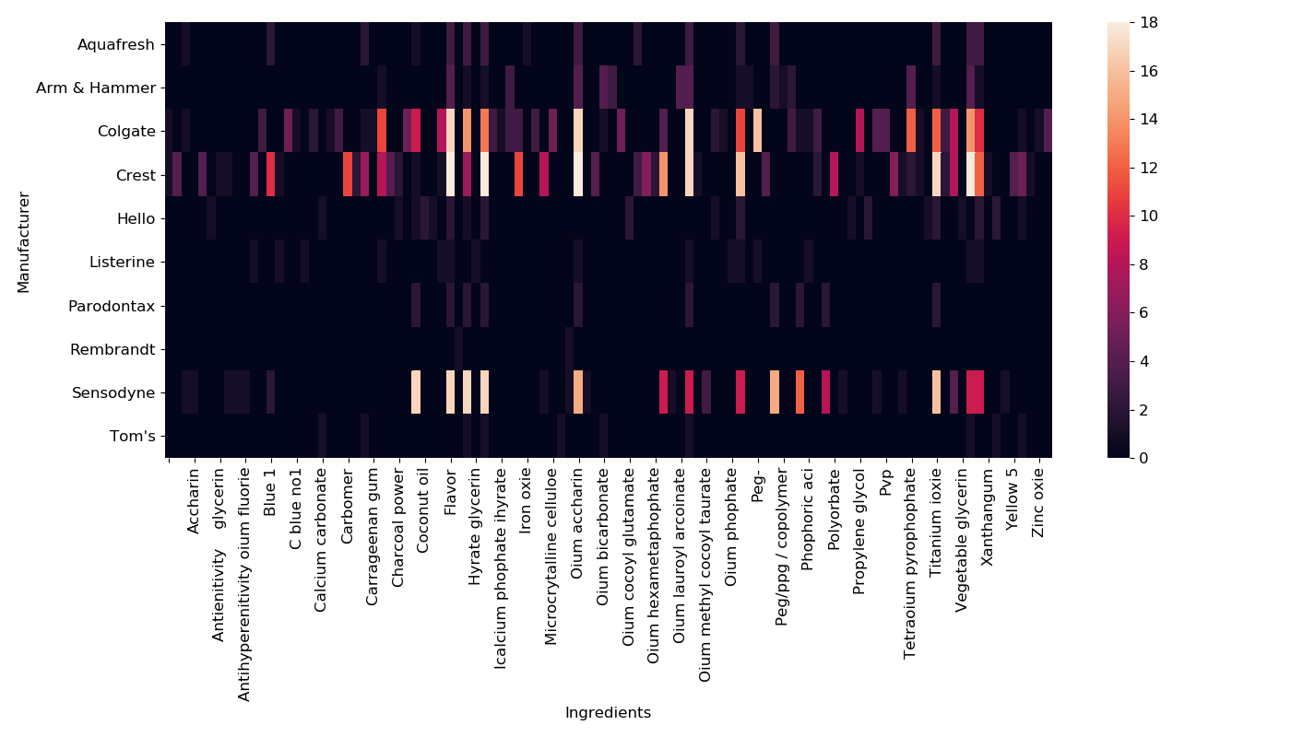
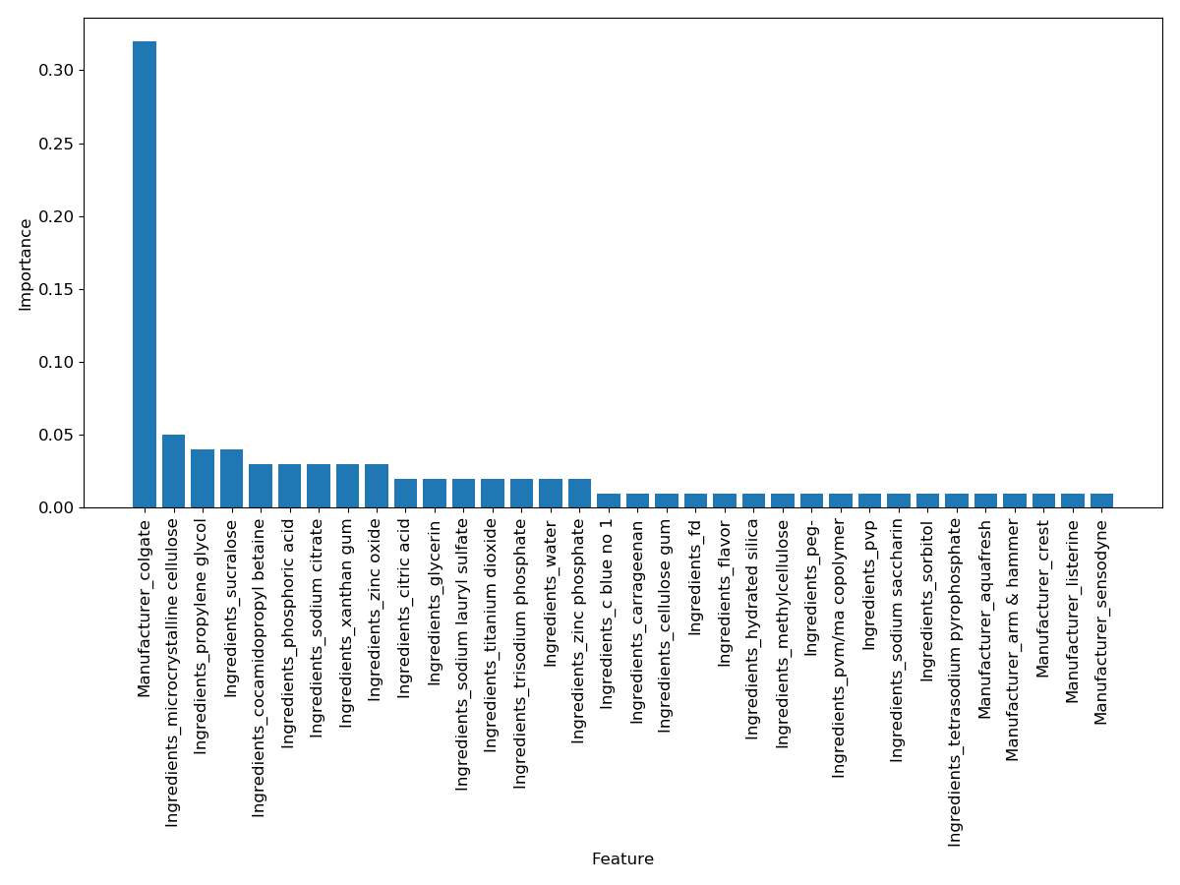
Formulations development and market analysis
Application Performance
Public Chemical/Materials Data

Slide 7
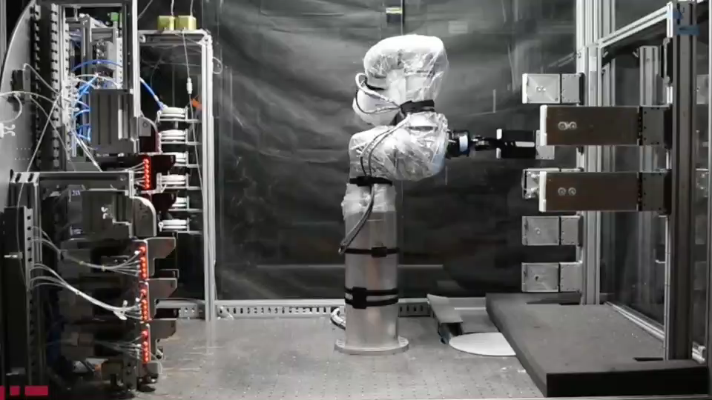
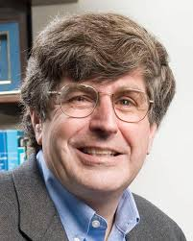
Automated chemical synthesis
Application Performance
Public Chemical/Materials Data

Slide 8
A new opportunity
Chemicals/Materials Design Company
Discovery/
Basic Research
Market/Customer
Discovery
Design
Manufacture
Open Knowledge Network: public-private partnership of chemical and materials data
opportunity
Application Performance
Public Chemical/Materials Data
innovation

Slide 9
A new opportunity
Chemicals/Materials Design Company
Discovery/
Basic Research
Market/Customer
Discovery
Design
Manufacture
Open Knowledge Network: public-private partnership of chemical and materials data
Focus Areas
Knowledge Platform Development
Product Programs
PhD Internship Program
Data Cleansing, Data Modeling
Collaborative Efforts
Training Courses
AI, ML tools and techniques
Market Needs Assessment
Other
Notes:
Make a list of the key activities needed across the spectrum, review with companies to add /modify
Prior to updates ask each company to comment on highest priority areas for their investment, what they would like ot see from the public investments

Slide 10
Agenda: Welcome
8:50AM Opening Remarks
Doug Maughan, National Science Foundation

Slide 11
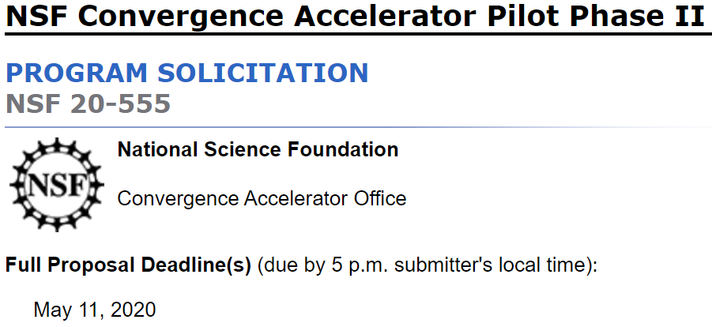
C-Accel Phase II
$5MM/2 years
$3MM/$2MM
https://www.nsf.gov/pubs/2020/nsf20555/nsf20555.htm
Track A: Open Knowledge Network

Slide 12

Open Knowledge Network (OKN)
An OKN would enable machine learning systems to enrich data with extensive information about the underlying objects and natural language systems to link words and sentences to meaningful descriptions and add context and world knowledge to robotic devices.
Knowledge graphs have demonstrated and are powering new capabilities for search and integrated services. Commercial successes present the opportunity to drive the next generation of technology to support research in academia, industry, and government, and to create new services and synergies that use both open and proprietary data.
Big Data Interagency Working Group
October 4–5, 2017, in Washington, DC
OpenKnowledgeNetwork

Slide 13
Open Knowledge Network (OKN)
Technology companies develop proprietary knowledge networks as key business technologies. An OKN requires a nonproprietary, public–private development effort that spans the entire data science community and results in an open, shared infrastructure.
Fusing these islands of knowledge currently requires enormous effort. Like the Internet, an OKN would provide such an infrastructure, building upon and significantly enhancing the capabilities of existing data resources.
Big Data Interagency Working Group
October 4–5, 2017, in Washington, DC
OpenKnowledgeNetwork

Slide 14
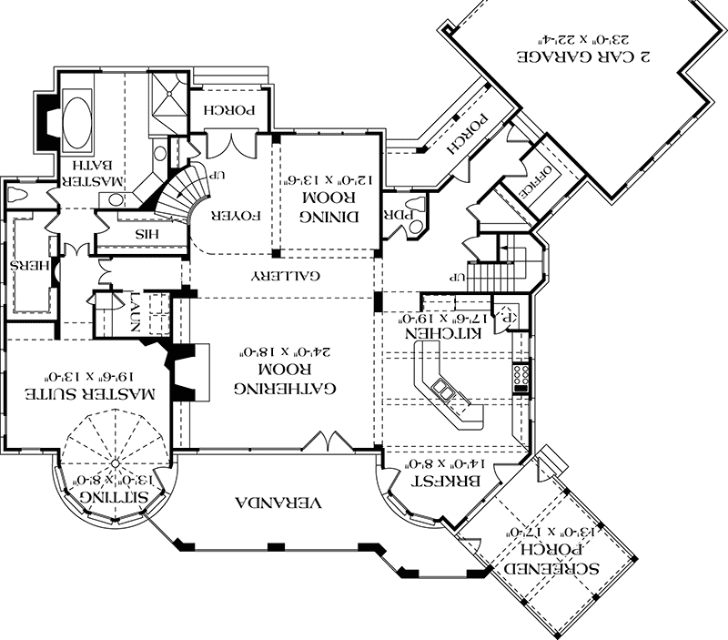
Keys to success of an OKN
Dynamic in nature: people
Accept input from a variety of sources: data
Link disparate information: tools
Create a network
to enable discovery and accelerate market needs assessment,
new product development, product life cycle analysis, and new modes of collaborative engagement.
Big Data Interagency Working Group
October 4–5, 2017, in Washington, DC
OpenKnowledgeNetwork

Slide 15
Connecting a user community
People
Data
Tools

Slide 16
Case study
Chris Greamo, TwoSix Labs

Slide 17
Support Models for Knowledge Network Platforms
9:00–9:30AM
Keynote: Chris Greamo, TwoSix Labs
Moderator: Seth Henshaw, TwoSix Labs

Slide 18
Discussion / Break
9:30–9:45AM
Moderator: Seth Henshaw, TwoSix Labs

Slide 19




Chemical and Materials Industries Data Challenges
9:45–11:20AM
Keynotes: Dow, Procter and Gamble (P&G), Suez
Participants: Evonik, Avantor, Ecolab
Moderator: Montgomery Alger, AIChE / PSU

Slide 20
Establishing priorities
Chemicals/Materials Design Company
Discovery/
Basic Research
Market/Customer
Discovery
Design
Manufacture
Open Knowledge Network: public-private partnership of chemical and materials data
Knowledge Platform Development
Messaging
PhD Internship Program
Product Programs
Data Scraping
App Development
Training Courses
Collaborative Efforts
AI, ML tools and techniques
User capacity
Undergraduate Interns
Market Needs Assessment
Online resources
Visualization tools
Data security
Other … ?
Notes:
Make a list of the key activities needed across the spectrum, review with companies to add /modify
Prior to updates ask each company to comment on highest priority areas for their investment, what they would like ot see from the public investments

Slide 21
Chemical and Materials Industries Data Challenges
9:50–10:20AM
Keynotes: Andre Argenton, Dow
Vice President of Research and Development
Moderator: Montgomery Alger, AIChE / PSU

Slide 22
Chemical and Materials Industries Data Challenges
10:20–10:50AM
Keynotes: Gerard Baillely, Procter and Gamble (P&G),
Vice President, Research and Development Corp. Functions
Moderator: Montgomery Alger, AIChE / PSU

Slide 23
Chemical and Materials Industries Data Challenges
10:50–11:20AM
Keynotes: C. Maltesh, Ashish Aneja; Suez
Director, Technology Innovation
Vice President - Digital, Innovation & Marketing
Director, Technology Innovation
Moderator: Montgomery Alger, AIChE / PSU

Slide 24


Discussion / Break
11:20–11:30AM
Moderator: Montgomery Alger, AIChE / PSU

Slide 25
Approaches for Chemicals & Materials Informatics
11:30AM–12:00PM
Keynotes: MPRINT, VCU and TwoSix Labs
Moderator: James Ferri, VCU

Slide 26

Approaches for Chemicals & Materials Informatics
12:00–12:30PM
Keynotes: Bob Sherman, Procter & Gamble
Moderator: James Ferri, VCU

Slide 27
Lunch Break / Open Discussion
12:30–1:30PM
Moderator: Justin Moore, VCU

Slide 28

Follow-up Discussion
1:30 PM –
Moderators: James Ferri, VCU and Andrew Lee, Hogan Lovells

Slide 29
Opportunities Now
https://www.nsf.gov/pubs/2018/nsf18102/nsf1802.jsp
https://www.nsf.gov/pubs/2019/nsf19582/nsf19582.htm

Slide 30

Discussion of next steps
Tools
People
Platform
Web Scrapers
Document Ingest
Visualizations
Machine Learning
Featurization
PhD Interns
Undergrad Interns
Tutorials/Videos
Training
Data Storage/Security
Knowledge Graphs
Messaging
Tool Workshop
User load capacity

Slide 31
Minimum Viable Segment
Minimum viable product
MVP
MVS
Minimum viable segment

Slide 32
C-Accel Phase II
$5MM/2 years
$3MM/$2MM
https://www.nsf.gov/pubs/2020/nsf20555/nsf20555.htm

Slide 33
Letter of Collaboration
Dear James,
THIS IS WHY WE ARE EXCITED ABOUT DEVELOPING AN OPEN KNOWLEDGE NETWORK
THIS IS WHAT ACTIVITIES WE ARE SPECIFICALLY INTERESTED IN SUPPORTING
THIS IS THE LEVEL OF FUNDING WE ARE PREPARED TO PROVIDE (DIRECT, OR IN-KIND)
Best Regards,
The Highest Signing Authority You Can Get

